Slide 1
Ford GoBike Visualization Project (Part 2 – Presentation)
For the Udacity Visualization Project Conducted in 2024
Completed by Manar Abdullah Al Rawahi

Slide 2
Investigation Overview
The main goal of this project is to analyze the Ford GoBike dataset to understand user behaviors, trip patterns, and demographics. By focusing on key features such as trip duration, start and end stations, user type, age group, and bike-sharing participation, the investigation sought to uncover how different user groups interact with the bike-sharing service.
Through detailed univariate, bivariate, and multivariate exploration, the project revealed that weekend trips tend to be longer, especially for customers and older users, suggesting more recreational use. In contrast, subscribers have more consistent, shorter trips, likely for commuting purposes. Additionally, gender differences were noted, with male users tending to take longer trips, particularly on weekends, while the “Other” gender showed more variability and longer trips overall. Station usage patterns, distance, and duration also revealed key insights into the most active stations and peak times. These findings provide valuable insights for optimizing the Ford GoBike service.

Slide 3
Dataset Overview
The dataset captures trip data from the Ford GoBike bike-sharing program, with 174,952 trips recorded after cleaning and 31 columns detailing user behavior and trip characteristics along with additional columns after transformation. Key features include trip duration (in seconds), start/end times, and start/end stations (with geographic coordinates). The dataset also provides demographic data such as user type (subscriber vs. customer), member birth year, and gender, allowing for analysis of trip patterns across different user groups and locations. Data types consist of a mix of numerical and categorical values, which support comprehensive exploration of bike usage trends.

Slide 4
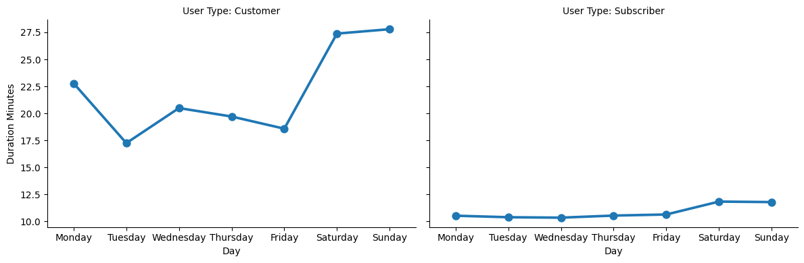
Trip Duration Across Weekdays by User Type
This visual introduces the overall user behavior between customers and subscribers. It shows how customers take longer trips on weekends, while subscribers have more consistent, shorter trips across the week.

Slide 5
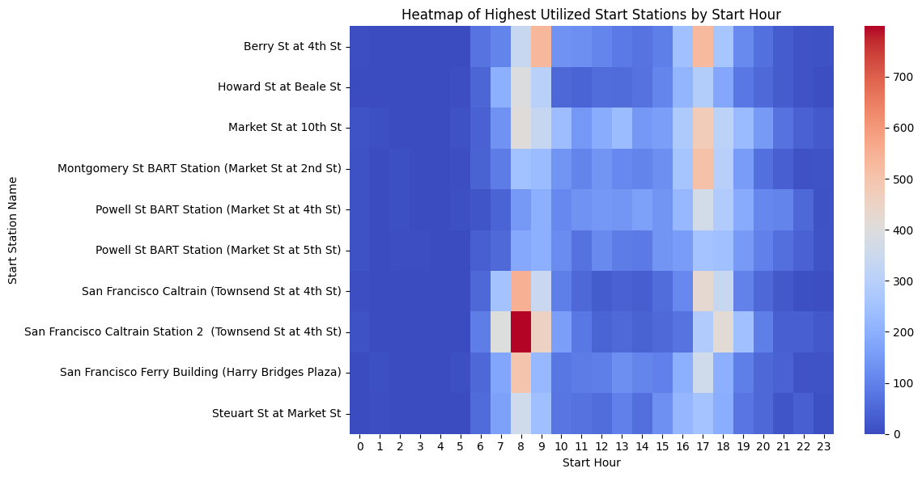

Heatmap of Start/End Stations by Hour
The start/end station heatmap highlights which stations are most active and during what times of the day. This reveals key insights about peak usage times and popular stations for different user groups.

Slide 6
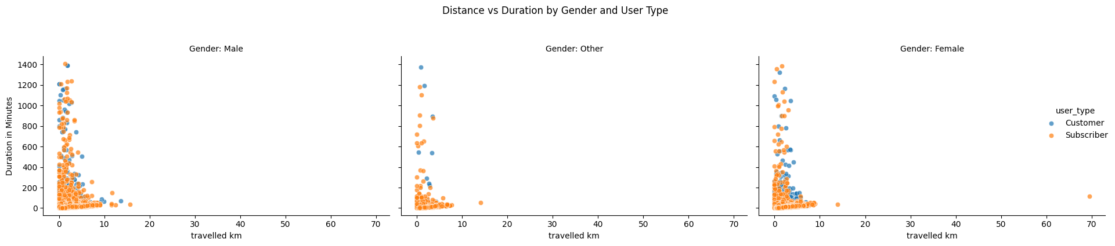
Distance Traveled vs. Duration by Gender and User Type
This plot connects trip distance with trip duration, faceted by gender and user type. It illustrates how subscribers tend to take shorter, routine trips across genders, while customers have longer, more variable trip patterns.

Slide 7
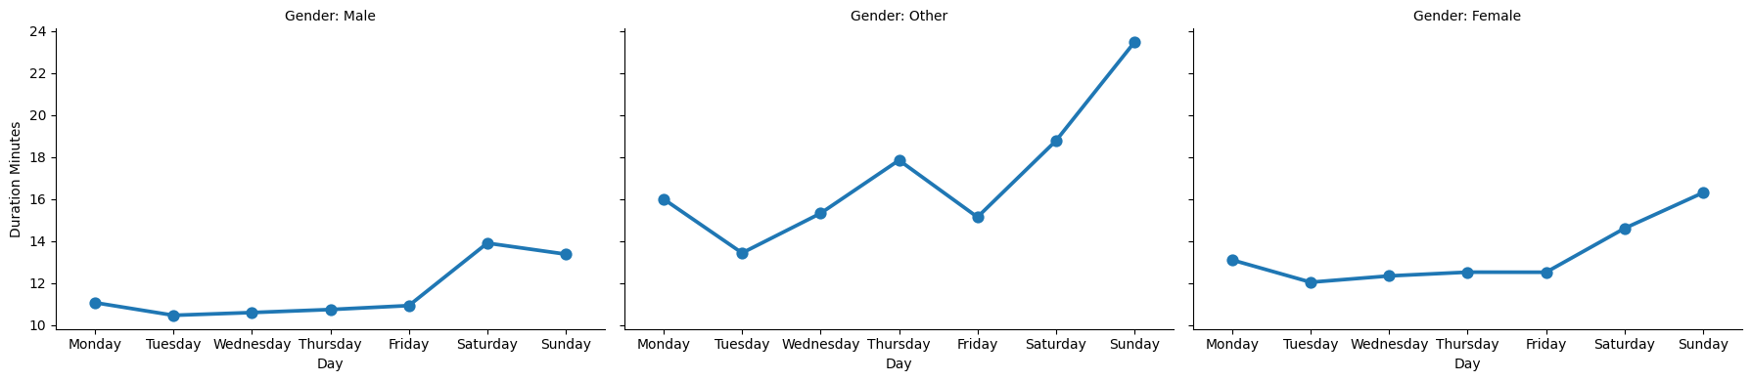
Trip Duration Across Weekdays by Gender
This shows that male users have slightly longer trip durations, with a noticeable peak during weekends, while female and other gender users follow similar but less pronounced trends.

Slide 8
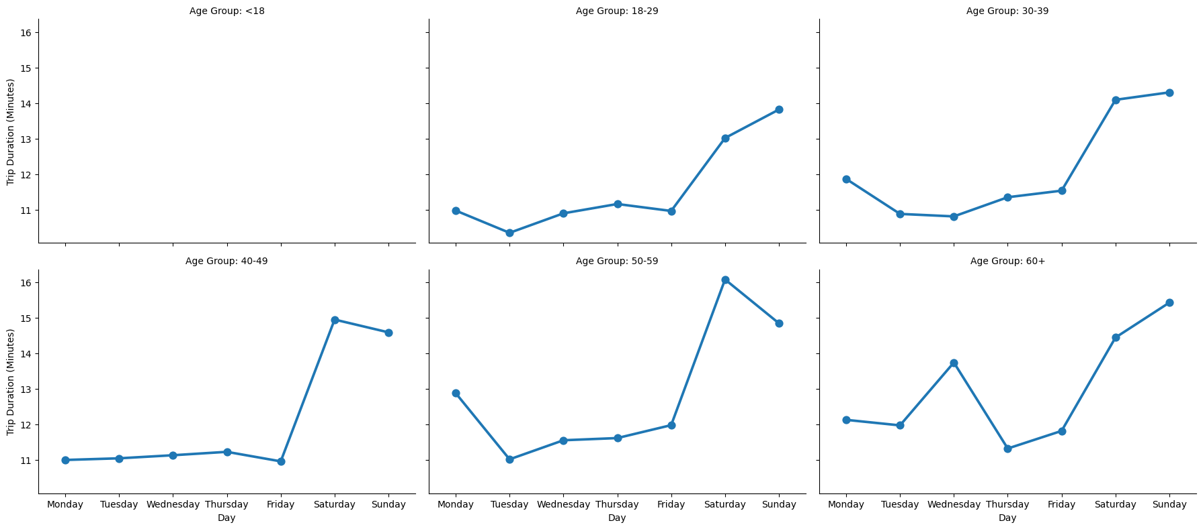
Trip Duration Across Weekdays by Age Group
This plot demonstrates the age-specific patterns in trip duration, showing that older age groups (50-59 and 60+) tend to take significantly longer trips during weekends, particularly on Sundays.

